Slide 1
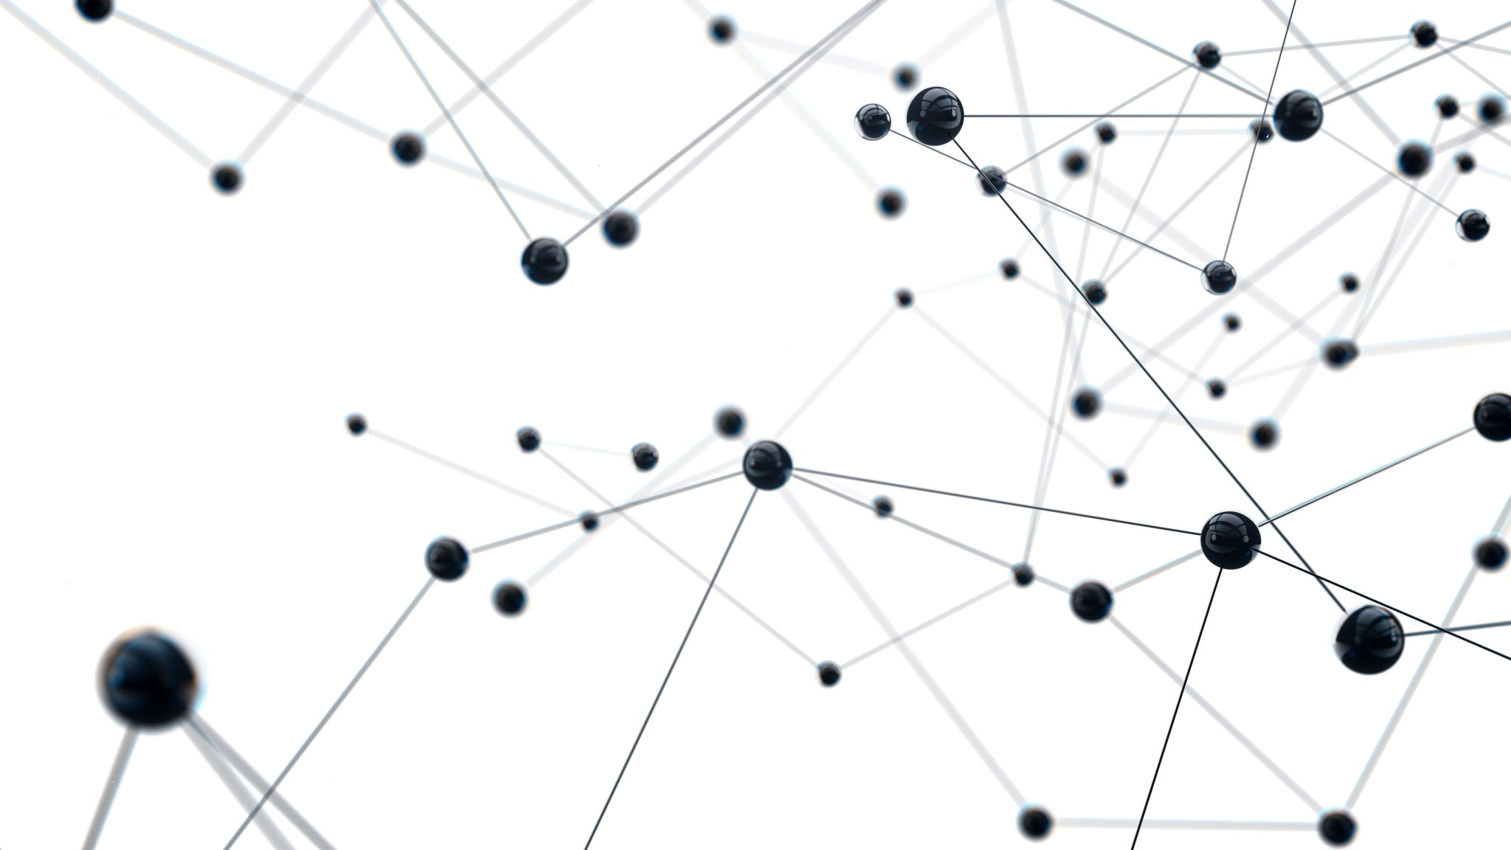
The History of the Personal Computer
Lesson 2

Slide 2
Learning Objectives
Differentiate IT and IS
Describe the earliest personal computer ever designed.
Describe the early computers.
Describe the development of the PC
List early application software that was developed for the PC.
Describe early successful web browsers.
Discuss the features of the Pascalene calculator and the Jacquard loom that inspired modern computer elements
Describe the milestones that led to each “generation” of computers.

Slide 3
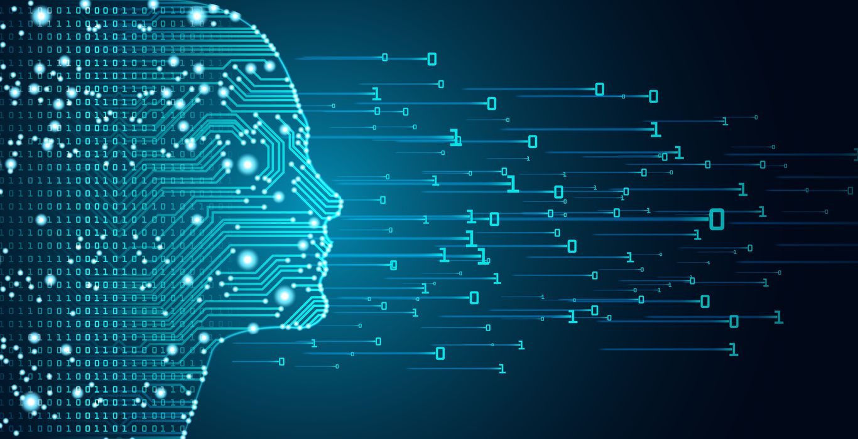
Three important Terminologies
Information systems (IS) is an umbrella term for the systems, people and processes designed to create, store, manipulate, distribute and disseminate information.
The field of information systems bridges business and computer science.
Information technology (IT) falls under the IS umbrella but deals with the technology involved in the systems themselves.
Information technology can be defined as the study, design, implementation, support or management of computer-based information systems
Computing is any goal-oriented activity requiring, benefiting from, or creating computing machinery.
It includes the study and experimentation of algorithmic processes and development of both hardware and software.

Slide 4
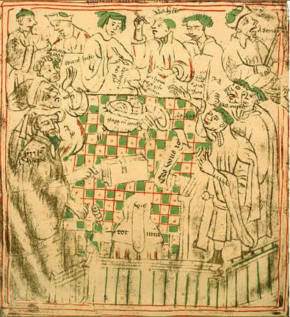
Three Generations of Calculating Devices
Analog
Abacus
Tally Sticks
Hybrid
Pascal
Leibnitz
Electronic
First-generation (1944) - Used vacuum tubes to store data
Second-generation (1945) - Used transistors to store data
Third-generation (1958) - Used integrated circuits
Fourth-generation (1971–today) - Uses microprocessor chip

Slide 5
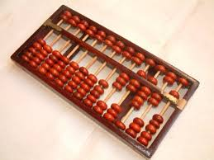
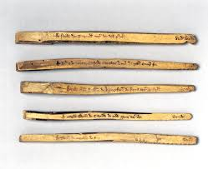
Identify these devices

Slide 6
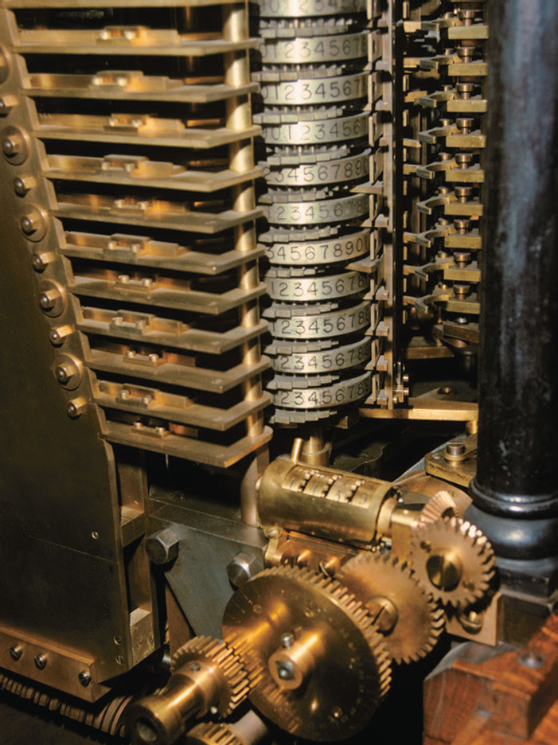
From Hollerith to Thomas Watson (Sr)
Hollerith Tabulating Machines Company sell Census Machine
Grows in to a Computer Giant by 1924 with more mergers and acquisitions – The International Business Machines

Slide 7
Early Personal Computers
The Altair 8800 debuted in 1975 touted as the first personal computer.
It appeared on the cover of Popular Electronics in 1975 and quickly there were hundreds of orders a month for the $395 box of parts.
Switches were used for input and lights for output and the machine had a total of 256 bytes of memory. (Today’s computers have 256000000 bytes!)
Bill Gates and Paul Allen saw the cover article left Harvard and flew to Albuquerque New Mexico convincing Altair’s developer that they could write a compiler to run the BASIC computer language on the Altair. Their success led to the formation of Microsoft.

Slide 8
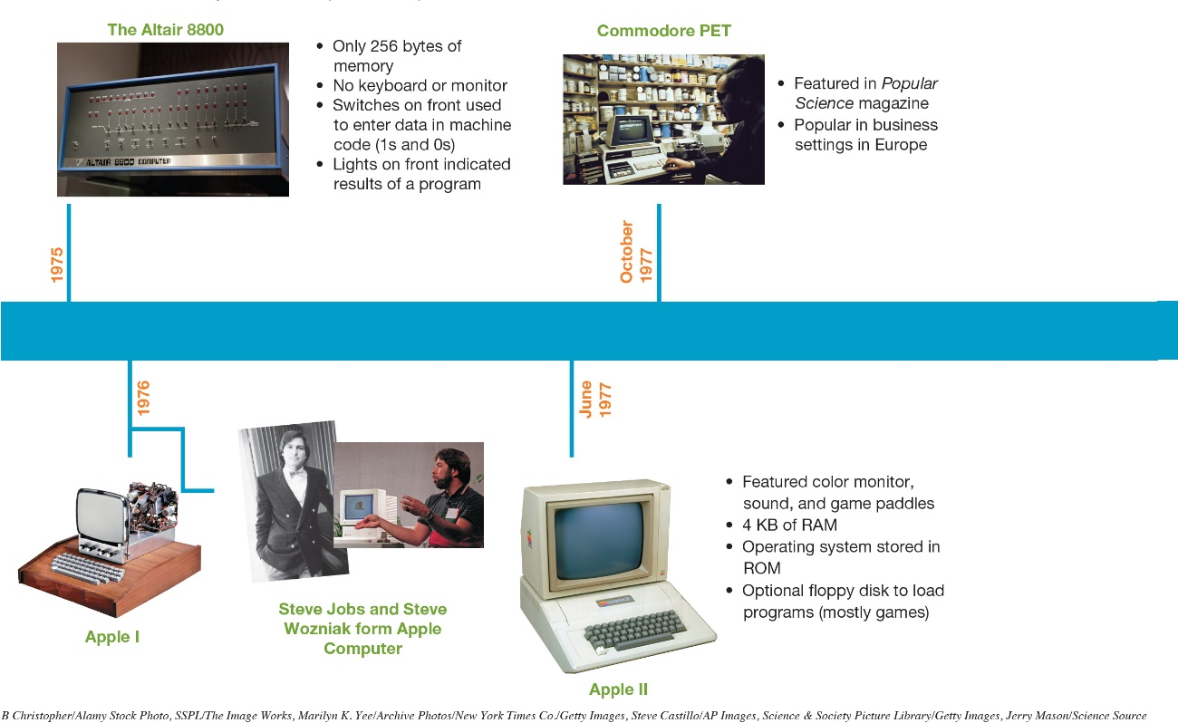
Early Personal Computers The Apple I and II
Built by Steve Jobs and Steve Wozniak
Operating system stored in ROM
8

Slide 9
Enter the Competition The Osborne: The Birth of Portable Computing
Introduced in 1981
Cost $1795
Weighed 24.5 pounds
5 inch screen
Overnight success
Sold to Compaq in 1983

Slide 10
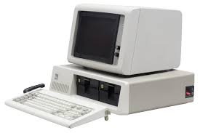
Enter the Competition IBM PCs
Prior to 1980: Known for mainframes
1981: Entered small-computer market with IBM PC
Started at $1565
Sold at retail outlets (Sears)
1982: Named “Machine of the Year”

Slide 11

Other Important Advancements
Storage Devices – Audio cassettes to Solid State drives
Processors – 8088 to Ryzen and i9
Programming Languages- BASIC to Java

Slide 12
Other Important Advancements
Word Processors
Electronic Spreadsheets
Presentation software
Database Management Systems
Graphic software
ERP and CRM

Slide 13
The Graphical User Interface and the Internet Boom
Graphical User Interface (GUI) allowed users to interact with computer more easily
Previously used command or menu driven interfaces
GUI not invented by a computer company
Xerox Alto (1972) Introduced “What You See Is What You Get” (WYSIWYG)
Mouse and network connectivity – but not sold commercially

Slide 14
Job and Woz change the computing world
Apple Lisa (1983)
First successful PC using GUI
Windows drop-down menus icons a file system with folders and files
Very expensive
Apple Macintosh (1984)
1/3 cost of Lisa
Introduced 3.5-inch floppy disk

Slide 15
Enter the WWW
Tim Berners Lee develop WWW and HTML
1993: Mosaic browser introduced
1994: Netscape launched
1995: Internet Explorer introduced by Microsoft
1998: Netscape became open source

Slide 16
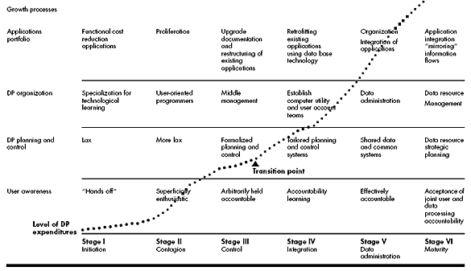
Richard Nolan – 6 Stages of Growth

Slide 17
Famous names
Charles Babbage
Augusta Ada
Seymore Cray
Mark Dean
Grace Hopper
Alan Turing
Steve Jobs
Bill Gates
Tim Berners-Lee

Slide 18
New Developments
Artificial Intelligence
Big Data
Presciptive analytics
Virtual and Augmented Reality

Slide 19
The End …until next time..

